Slide 1

Data Analytics Using Python Dr. Ziping Liu
Chapter 2 Numpy

Slide 2
https://he.kendallhunt.com/product/data-analytics-using-python
Chapter 2 Numpy

Slide 3
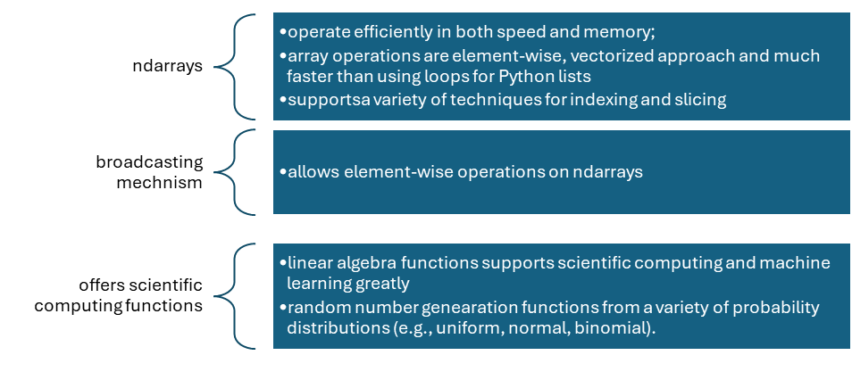
Why NumPy
NumPy, short for Numerical Python
a Python package for scientific computing to handle large, multidimensional arrays and matrices efficiently
core data structure: ndarray (n-dimensional array)
restricted to a single data type
compared to Python list, ndarrays are much faster and use less memory

Slide 4
Installation and Testing
Installation and testing
If you only have Python installed on your system, you will need to install NumPy
If you have Anaconda installed, you can check whether NumPy is already installed on your system
Using pip: | Using conda:
pip install numpy | conda install numpy
Verifying the installation: import numpy as np print(np.__version__)
Testing the NumPy installation using a simple script: import numpy as np arr = np.array([10, 20, 30, 40, 50]) print(arr)

Slide 5
Getting Started with NumPy
ndarray
can store and manipulate large datasets
comparison between NumPy ndarray and Python list
 | NumPy ndarray: | Python list:
speed | faster with element-wise ops | slower with loops
data types | homogeneous | heterogenous
size | fixed once created | can be updated

Slide 6
Getting Started with NumPy
Use NumPy and create ndarray
import the package: import numpy as np
create an ndarray: see examples in the textbook
function | description
array(sequence) | creates an array with an existing sequence passed in
random functions: rand(), randn(), normal() | generate arrays with random numbers
arange(start, end, exclusive, step) | returns an array having sequence of numbers with specified step and values are generated within the half-open interval [start, end)
linspace(start, end and number of items) | returns array having a specified number of elements
zeros() | creates a ndarray with all zeros
ones() | creates a ndarray with all ones

Slide 7
NumPy Basic Operations
universal functions (ufuncs), optimized for element-wise operations: see examples in the textbook
Arithmetic operations: +, -, *, /, %,
Mathematical operations: np.add, np.subtract, np.multiply, np.divide, np.power,
Trigonometric functions: np.sin, np.cos, np.tan,
Logarithmic functions: log, log10, log2, log1p,
Statistical functions: np.mean, np.median, np.std, np.var,
Comparisons: ==, !=, <, >, <=, >=,
Logical operations: AND, OR, NOT

Slide 8
NumPy Basic Operations
Vectorization
like mathematical vector operations, operations can also be applied over entire arrays simultaneously instead of using loops to process one element at a time
characterized by two key concepts: element-wise operations and broadcasting
vectorization is significantly faster than using loops: see textbook example
broadcasting in NumPy facilitates this by expanding the smaller array to match the shape of the larger one before executing the operation when operations involve arrays of different shapes: see textbook example

Slide 9
Indexing and Slicing
Indexing: using a single index value or multiple index values, see textbook example
Slicing: retrieving a sequence or block of elements from an array. The result of slicing is a shallow copy, which can be modified. see textbook example
When indexing and slicing are applied to multi-dimensional arrays, various sections of the array can be accessed
In slicing, the colon (:) retrieves all elements along a specific dimension, and the ellipsis (...) produces a complete indexing tuple with as many colons as needed
Slicing can also be used to expand an existing array by inserting a new dimension. see textbook example

Slide 10
Indexing and Slicing
Fancy indexing
use indexing with arrays of indices to select multiple elements from an axis: see textbook example
use an array of indices on a multidimensional array to create a new array by selecting specific rows or columns: see textbook example

Slide 11
Indexing and Slicing
Boolean indexing
Boolean arrays are arrays where elements have values of either True or False, and they can be used for indexing: see textbook example

Slide 12
Various Operations
argmax() and argmin() functions
argmax(): find the index of the maximum value(s) along a specified axis in an array, such as axis = 0, axis = 1, etc. See textbook example
argmin(): find the index of the manimum value(s) along a specified axis in an array, such as axis = 0, axis = 1, etc. See textbook example

Slide 13
Various Operations
operations along a specified axis: see textbook example
sum()
mean()
cumsum()
sort()
argsort()

Slide 14
Various Operations
reshape: change the dimension of an array either by creating a new view with the specified dimensions or by modifying the array itself. See textbook example
Function | Description
reshape() | parameter list: a tuple of integers or a single integer. return: a new view of the array, original array is not altered.
ravel() | parameter list: return: a flattened array of one dimension, the original array is not altered.
resize() | parameter list: a tuple of integers or a single integer. return: a new view of the array, original array is altered.
np.transpose()/T | parameter list: a tuple of integers for the permutation of the axes. If not provided, the default is to reverse the order of the axes. return: a new view of the array, original array is not altered.

Slide 15
Various Operations
Concatenating and Splitting Array: see textbook example
concatenate(): specify arrays and axis
split(): specify array and axis

Slide 16
Various Operations
Array data type conversion: see textbook example
determine the data type of a NumPy array using the dtype attribute
convert an array’s data type from one dtype to another using NumPy’s astype() method

Slide 17
Structured Array
supports arrays where different columns can have different data types
each column (field) can have a distinct data type, which is specified using a list of field names and their corresponding data types
see textbook example

Slide 18
Importing Data from files in NumPy
several methods to load data from text-based files, including .csv files
genfromtxt(),
loadtxt(),
fromfile(),
load().
genfromtxt() is flexible in handling data with various data types and delimiters: see textbook example

